Slide 1
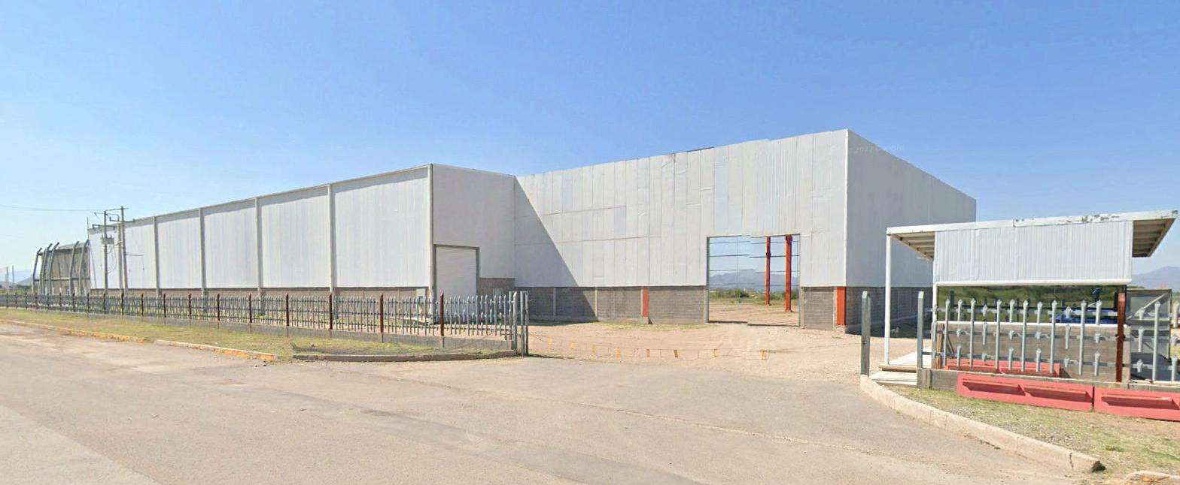
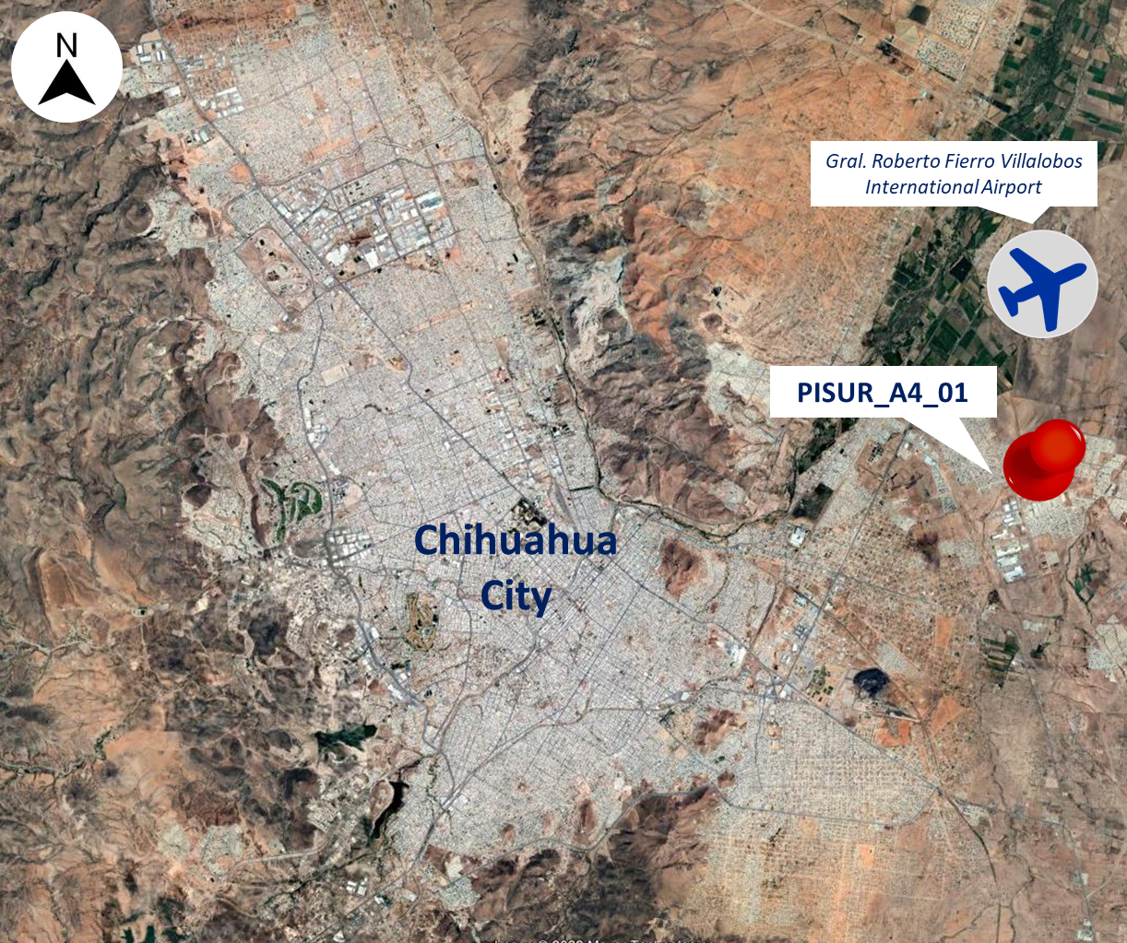
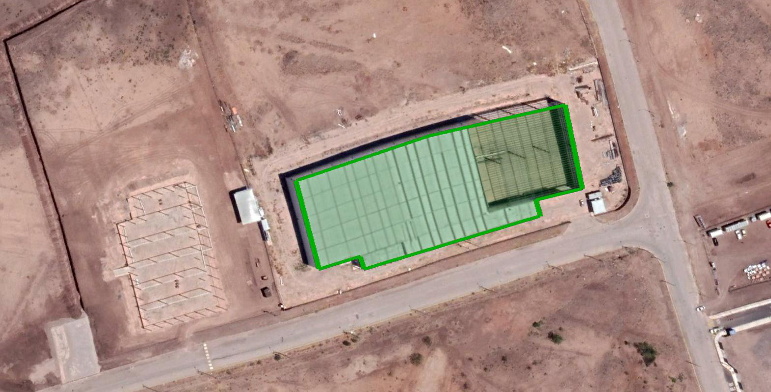
PISUR_A4_01
Industrial Space: 80,729 SF (7,500 m²)
Parque Industrial Sur | Chihuahua City | Mexico
HIGHLIGHTS
Located in one of the industrial parks with great development potential in the city.
Close to the city airport.
With access to the main highways in the area.
Building Specifications
Building area | 80,729 sf (7,500 m²)
Office area | 4,306 sf (400 m²)
Land area | 505,903 sf (47,000 m²)
Height | 39.37’ (12 m)
C. Construccion y C. Metalmecanica, Parque Industrial Sur
Chihuahua, Chihuahua, C.P 31385
AERIAL VIEW

